Slide 1
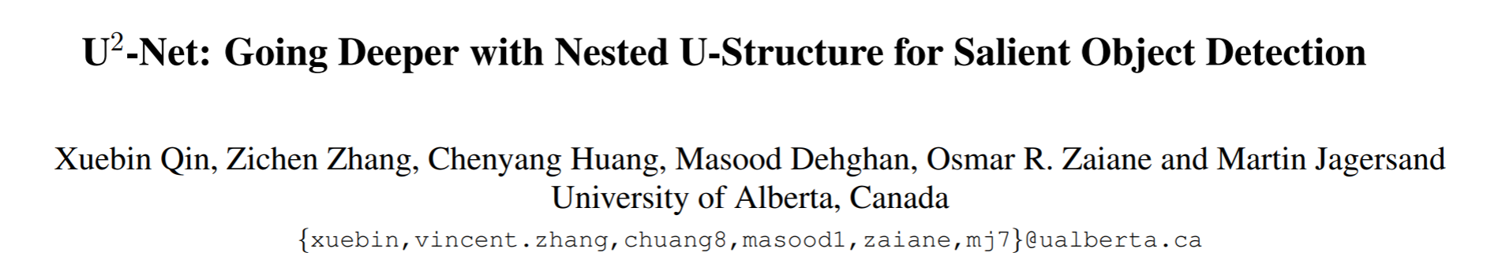

Slide 2
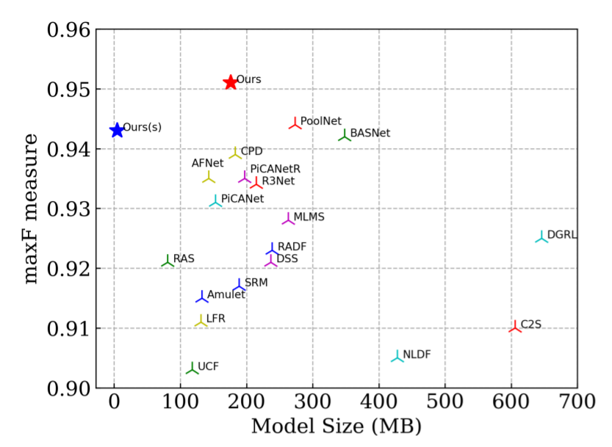
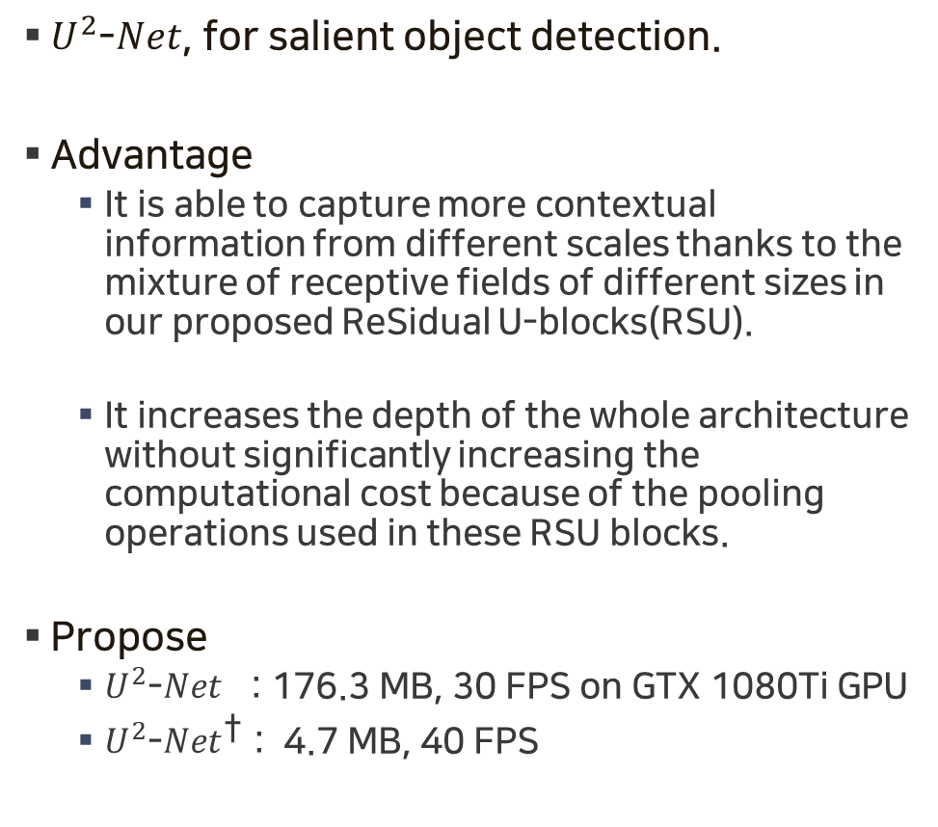
Abstract
$U^{2}$-$Net$, for salient object detection.
Advantage
It is able to capture more contextual information from different scales thanks to the mixture of receptive fields of different sizes in our proposed ReSidual U-blocks(RSU).
It increases the depth of the whole architecture without significantly increasing the computational cost because of the pooling operations used in these RSU blocks.
Propose
$U^{2}$-$Net$ : 176.3 MB, 30 FPS on GTX 1080Ti GPU
$U^{2}$-$Net^{\text{†}}$ : 4.7 MB, 40 FPS

Slide 3
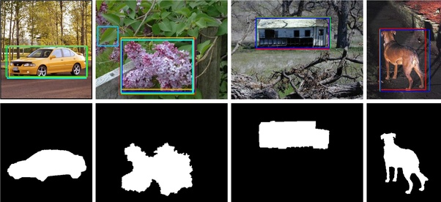
Saliency Object Detection
Salient Object Detection (SOD) aims at segmenting the most visually attractive objects in an image
SOD(Saliency Object Detection) : 중요한 물체를 검출하는 방법
FD(Fixation Prediction) : 사람의 시선이 어디에 가장 오래 머물지 예측하는 방법

Slide 4
Introduction
There is a common pattern in the design of most SOD networks, that is, they focus on making good use of deep features extracted by existing backbones, such as Alexnet, VGG, ResNet, ResNeXt, DenseNet, etc.
However, these backbones are all originally designed for image classification.
They extract features that are representative of semantic meaning rather than local details and global contrast information, which are essential to saliency detection.
And they need to be pretrained on ImageNet data which data-inefficient especially if the target data follows a different distribution than ImageNet.
This leads to our first question: can we design a new network for SOD, that allows training from scratch and achieves comparable or better performance than those based on existing pre-trained backbones?

Slide 5
Issues on the network architectures for SOD
First, they are often overly complicated. It is partially due to the additional feature aggregation modules that are added to the existing backbones to extract multilevel saliency features from these backbones.
Secondly, the existing backbones usually achieve deeper architecture by sacrificing high resolution of feature maps.
This leads to our first question: can we go deeper while maintaining high resolution feature maps, at a low memory and computation cost?

Slide 6
Related Works
Multi-level deep feature integration
= methods mainly focus on developing better multi-level feature aggregation strategies.
Multi-scale feature extraction
= target at designing new modules for extracting both local and global information from features obtained by backbone networks.

Slide 7
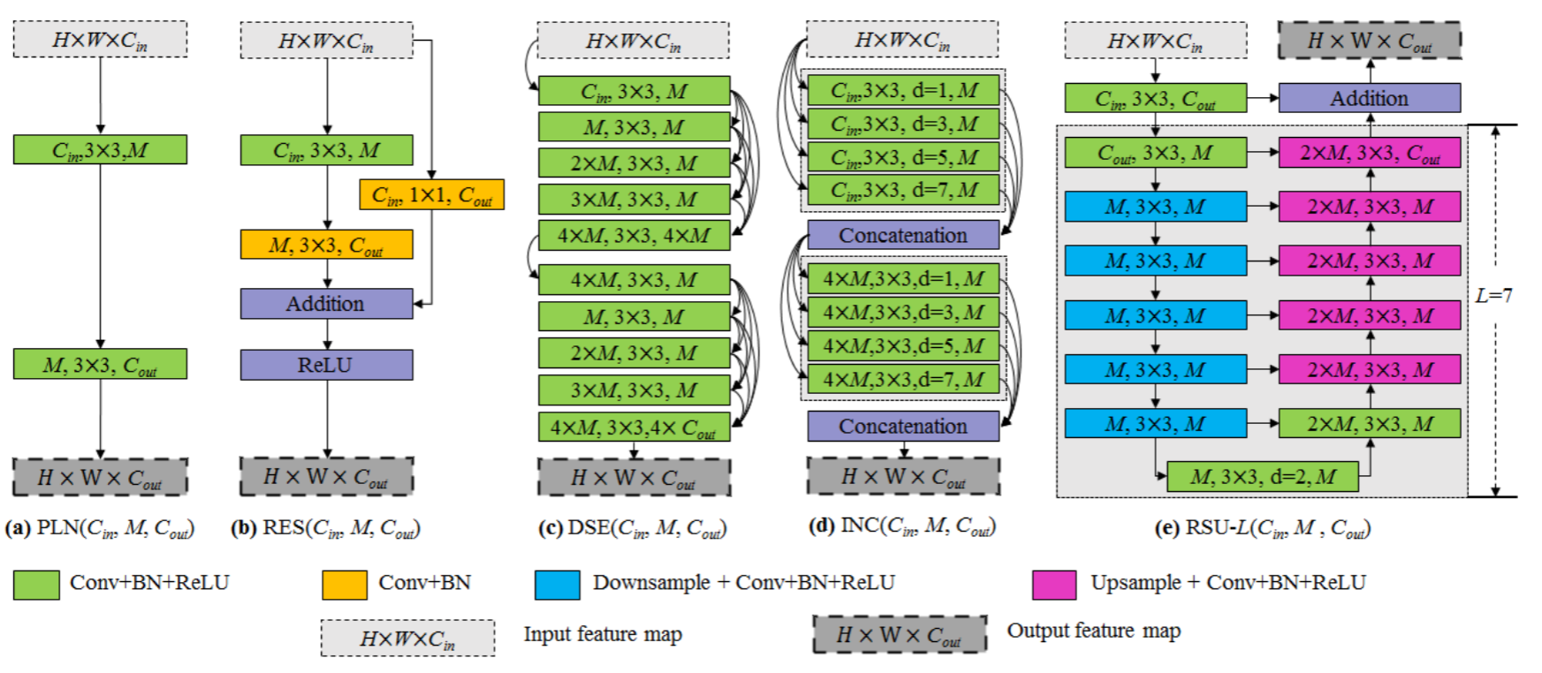
RSU
too much computation and memory resources
Low receptive field
proposed

Slide 8
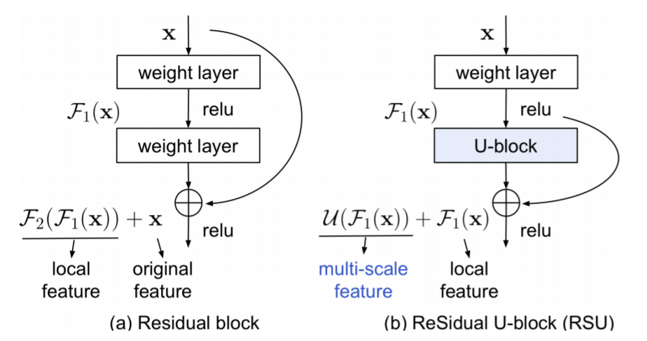
RSU
To decrease the computation costs, PoolNet adapt the parallel configuration from pyramid pooling modules (PPM), which uses small kernel filters on the downsampled feature maps other than the dilated convolutions on the original size feature maps. But fusion of different scale features by direct upsampling and concatenation (or addition) may lead to degradation of high resolution features.
Conv layer

Slide 9
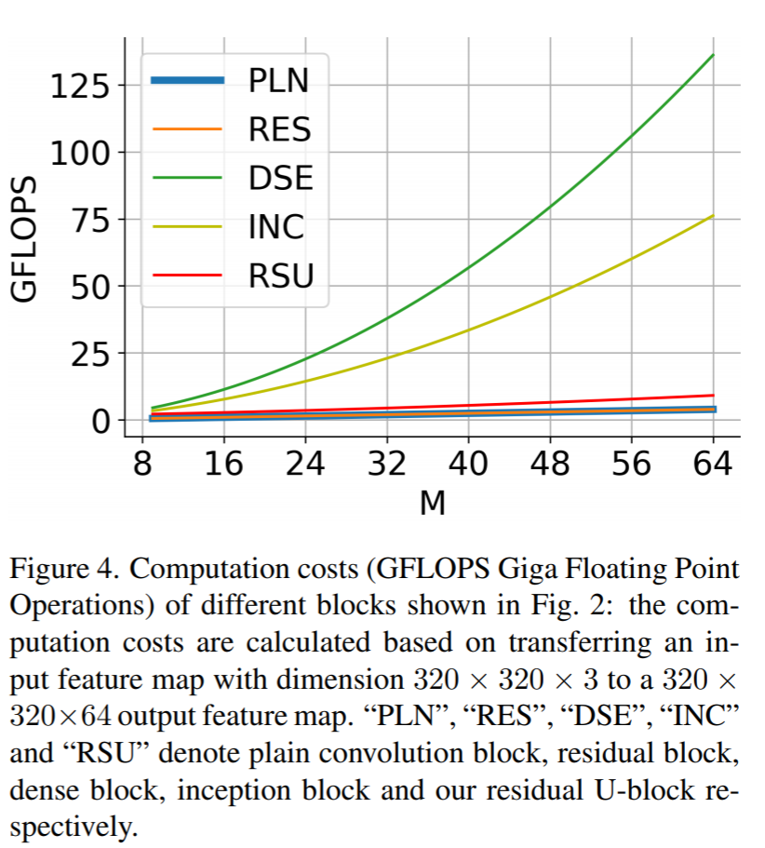
RSU

Slide 10
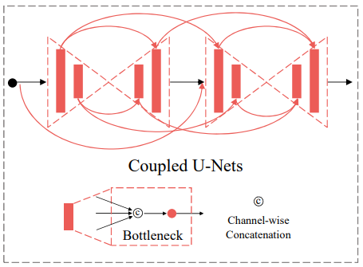
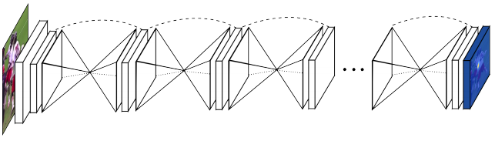
Architecture
U x $n$-Net : Repeat Unet n times. (stacked hourglass network, DocUNet, CU-Net)
$U^{n}$-Net : Our exponential notation refers to nested U-structure rather than cascaded stacking.

Slide 11
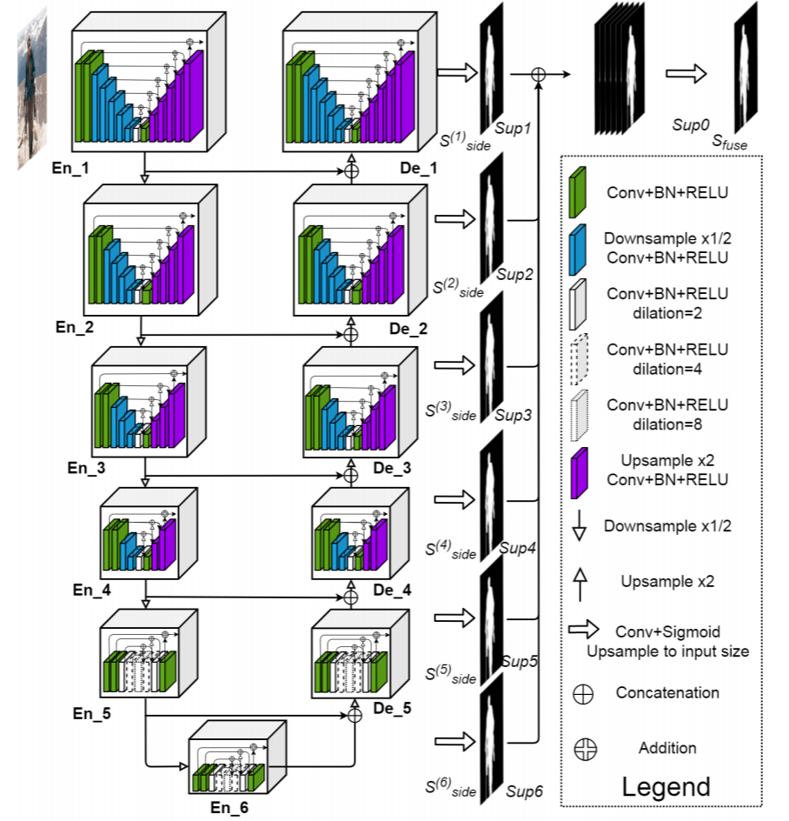
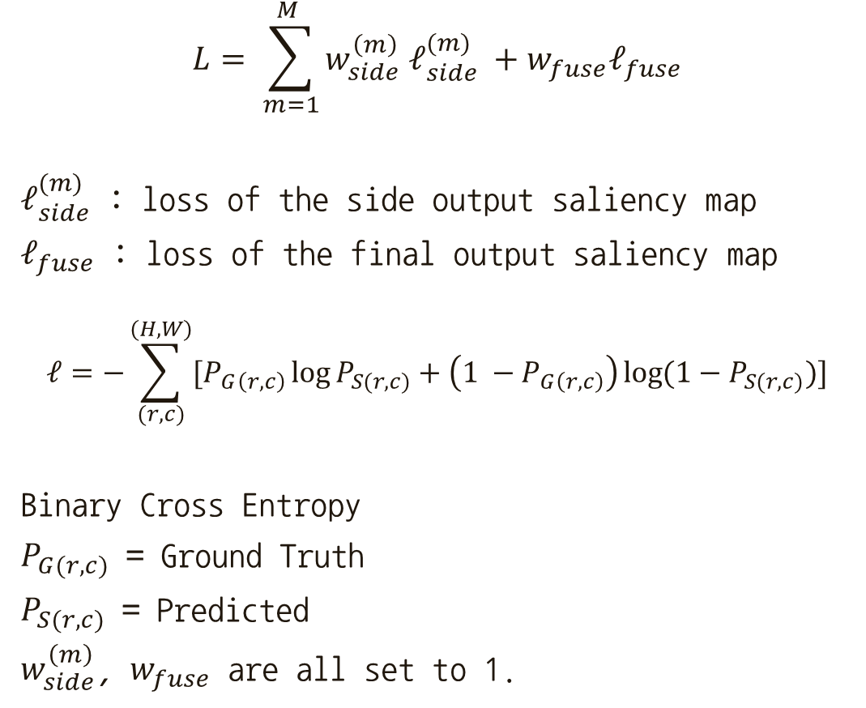
$U^{2}$-$Net$
$$L= \sum_{m=1}^{M }{w_{side}^{\left(m\right)} ℓ_{side}^{(m)} +w_{fuse}ℓ_{fuse}}$$
$ℓ_{side}^{(m)}$ : loss of the side output saliency map
$ℓ_{fuse}$ : loss of the final output saliency map
$$ℓ=−\sum_{(r, c)}^{(H, W)}{[P_{G\left(r, c\right)}\log{P_{S(r,c)}+\left(1 −P_{G\left(r,c\right)}\right)\log{(1−P_{S(r,c)})}}]}$$
Binary Cross Entropy
$P_{G(r,c)}$ = Ground Truth
$P_{S(r,c)}$ = Predicted
$w_{side}^{\left(m\right)}$, $w_{fuse}$ are all set to 1.
RSU-4F
Relatively low resolution.

Slide 12
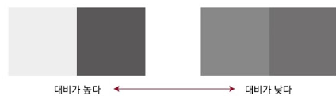
Dataset
Training
DUTS-TR contains 10553 images in total. Currently, it is the largest and most frequently used training dataset for salient object detection. We augment this dataset by horizontal flipping to obtain 21106 training images offline
Evaluation
DUT-OMRON includes 5168 images, most of which contain one or two structurally complex foreground objects.
DUTS-TE, which contains 5019 images.
HKU-IS contains 4447 images with multiple foreground objects.
ECSSD contains 1000 structurally complex images and many of them contain large foreground objects.
PASCAL-S contains 850 images with complex foreground objects and cluttered background.
SOD only contains 300 images. But it is very challenging. Because it was originally designed for image segmentation and many images are low contrast or contain complex foreground objects overlapping with the image boundary.

Slide 13
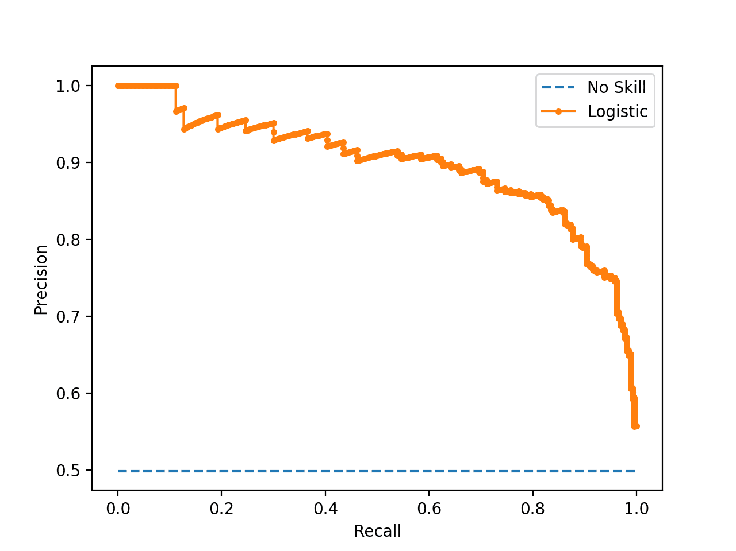
Evaluation Metrics
Predict : 0 ~ 1
GT : 0 or 1
PR curve : set of precision-recall paris, threshold 0 ~ 1 of predicted pixels.

Slide 14
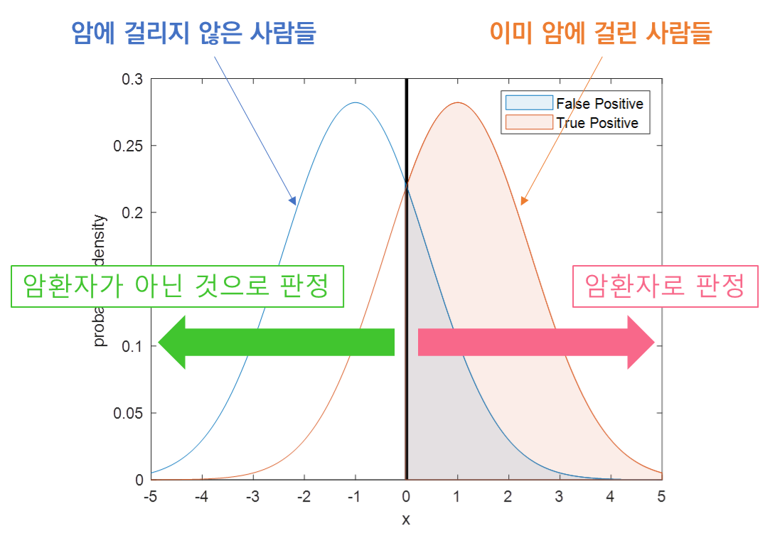
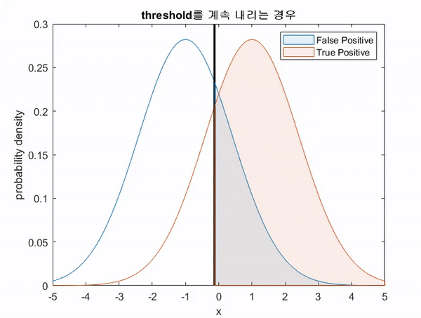
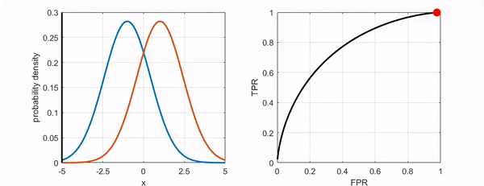
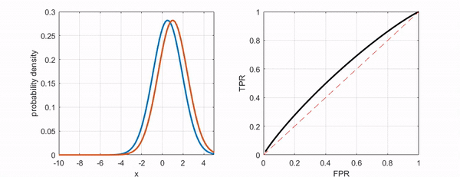
ROC-curve
https://angeloyeo.github.io/2020/08/05/ROC.html
Notes:
https://angeloyeo.github.io/2020/08/05/ROC.html

Slide 15
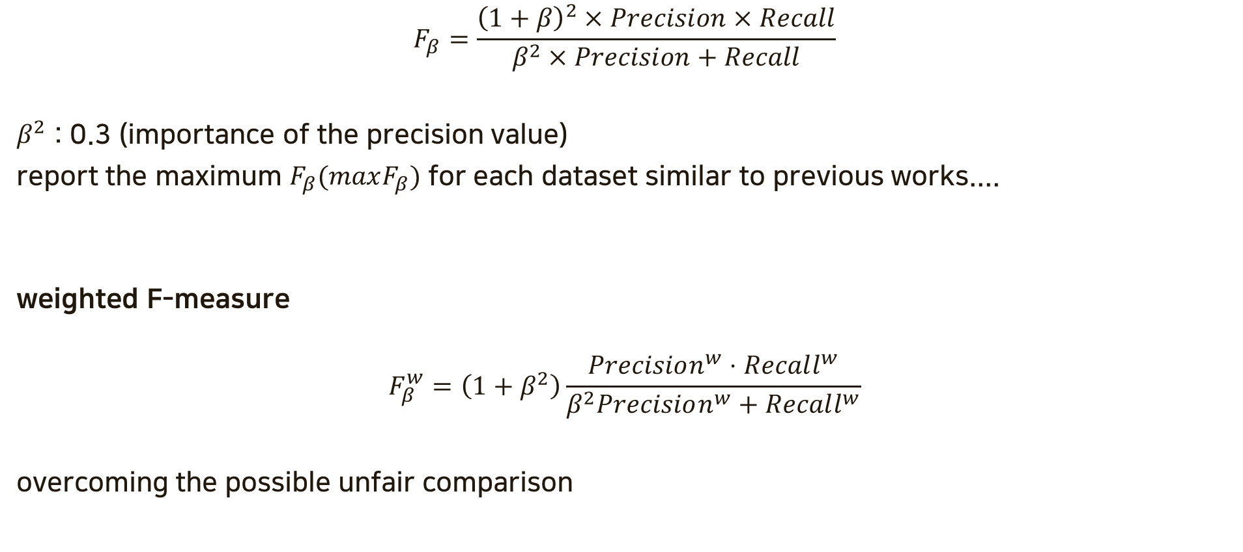
F-measure
$$F_{β}=\frac{{\left(1+β\right)}^{2}×Precision×Recall}{β^{2}×Precision+Recall}$$
$β^{2}$ : 0.3 (importance of the precision value)
report the maximum $F_{β}(maxF_{β})$ for each dataset similar to previous works....
weighted F-measure
$$F_{β}^{w}=\left(1+β^{2}\right)\frac{Precision^{w}⋅Recall^{w}}{β^{2}Precision^{w}+Recall^{w}}$$
overcoming the possible unfair comparison

Slide 16
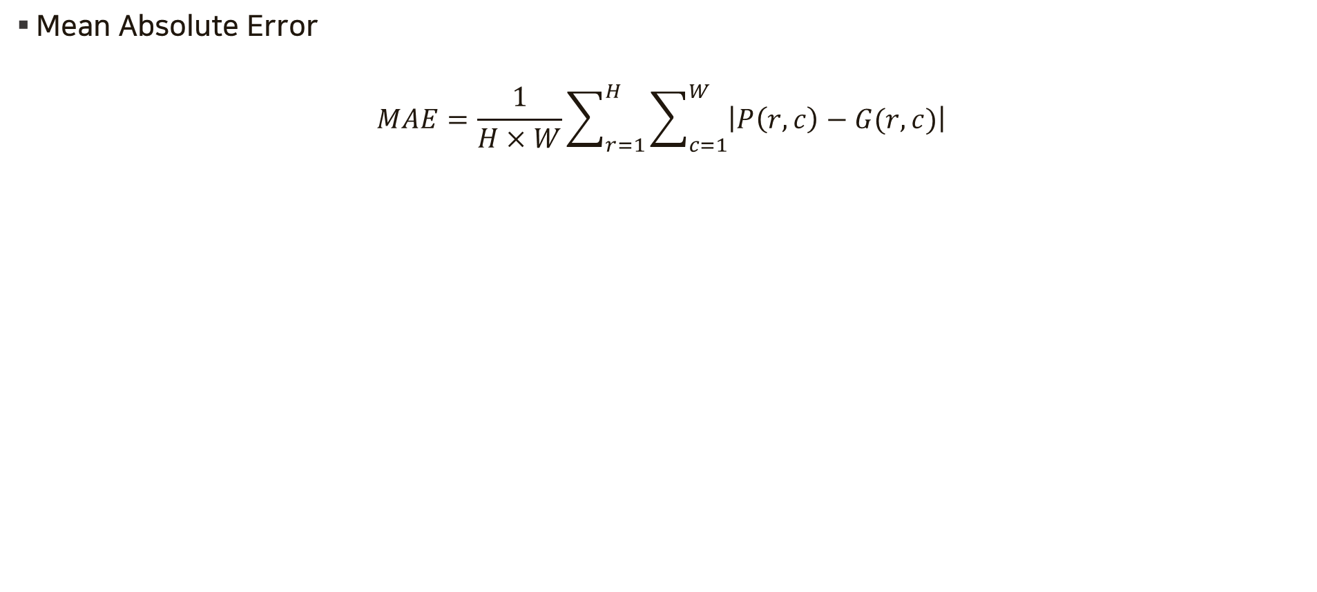
MAE
Mean Absolute Error
$$MAE=\frac{1}{H×W}\sum_{r=1}^{H}{\sum_{c=1}^{W}{\left|P\left(r,c\right)−G(r,c)\right|}}$$

Slide 17
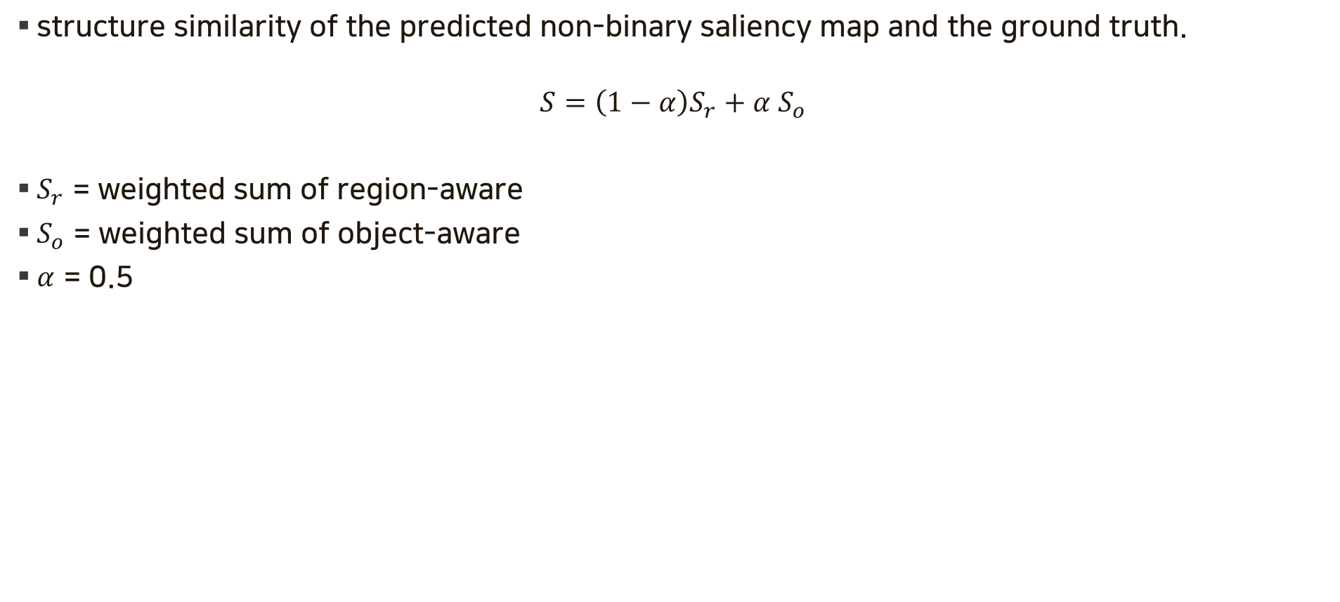
S-measure($S_{m}$)
structure similarity of the predicted non-binary saliency map and the ground truth.
$$S=\left(1−α\right)S_{r}+α S_{o}$$
$S_{r}$ = weighted sum of region-aware
$S_{o}$ = weighted sum of object-aware
$α$ = 0.5

Slide 18
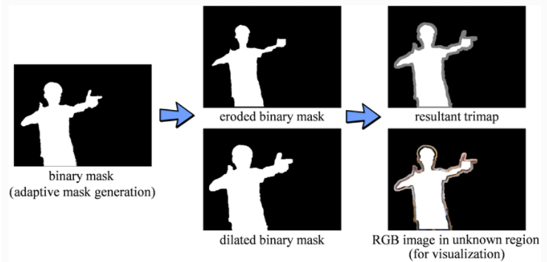
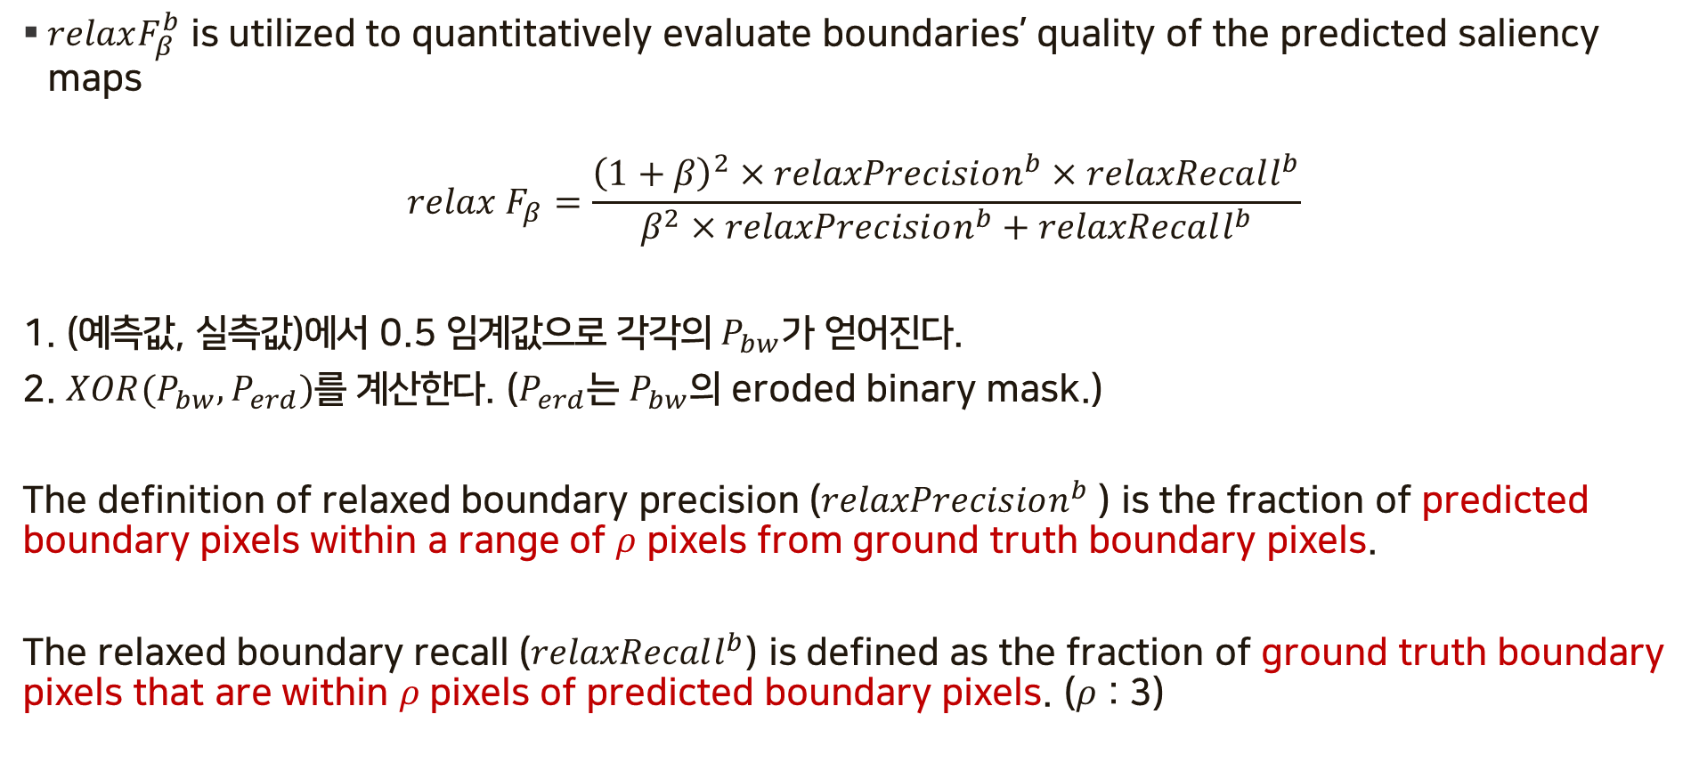
Relax boundary F-measure
$relaxF_{β}^{b}$ is utilized to quantitatively evaluate boundaries’ quality of the predicted saliency maps
$$relax F_{β}=\frac{{\left(1+β\right)}^{2}×relaxPrecision^{b}×relaxRecall^{b}}{β^{2}×relaxPrecision^{b}+relaxRecall^{b}}$$
1. (예측값, 실측값)에서 0.5 임계값으로 각$각의 P_{bw}$가 얻어진다.
2. $XOR(P_{bw}, P_{erd})$를 계산한다. ($P_{erd}$는 $P_{bw}$의 eroded binary mask.)
The definition of relaxed boundary precision ($relaxPrecision^{b}$) is the fraction of predicted boundary pixels within a range of $ρ$ pixels from ground truth boundary pixels.
The relaxed boundary recall ($relaxRecall^{b}$) is defined as the fraction of ground truth boundary pixels that are within $ρ$ pixels of predicted boundary pixels. ($ρ$ : 3)

Slide 19
Implementation Detail
first resized to 320×320 -> randomly flipped vertically -> cropped to 288×288.
Adam(initial learning rate lr=1e-3, betas=(0.9, 0.999), eps=1e-8, weight decay=0)
After 600k iterations (with a batch size of 12), the training loss converges and the whole training process takes about 120 hours.
Both training and testing are conducted on an eight-core, 16 threads PC with an AMD Ryzen 1800x 3.5 GHz CPU (32GB RAM) and a GTX 1080ti GPU (11GB memory).

Slide 20
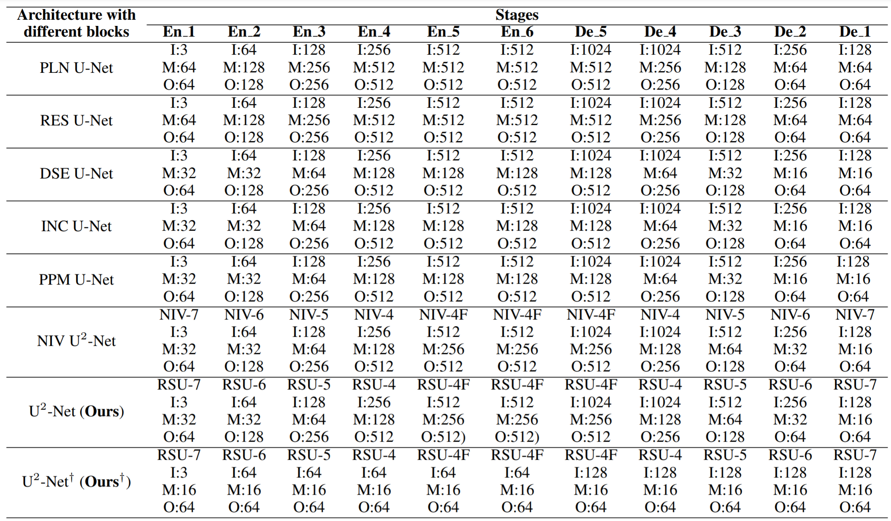
Ablation on Blocks
Pyramid
Pooling
Module
Naive

Slide 21
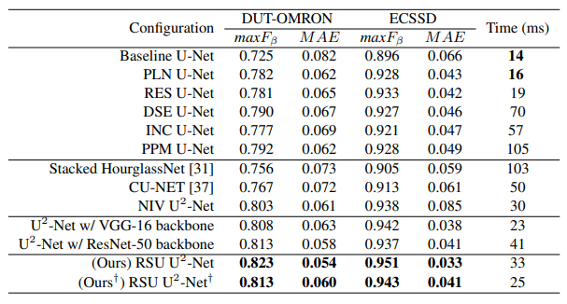
Results of ablation study on different blocks.
Block
Architecture
encoder
-> backbone

Slide 22
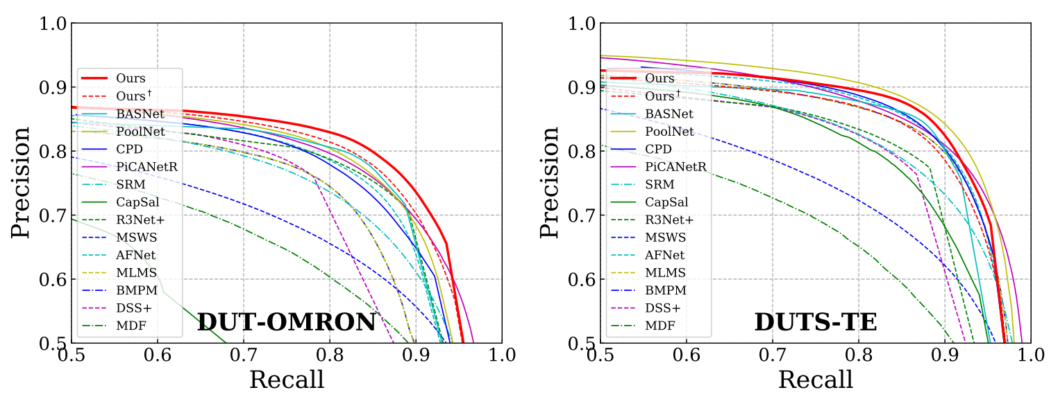
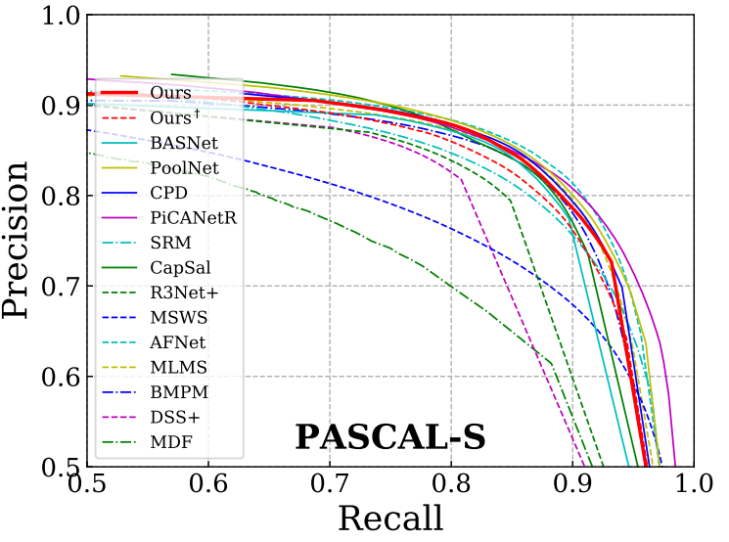
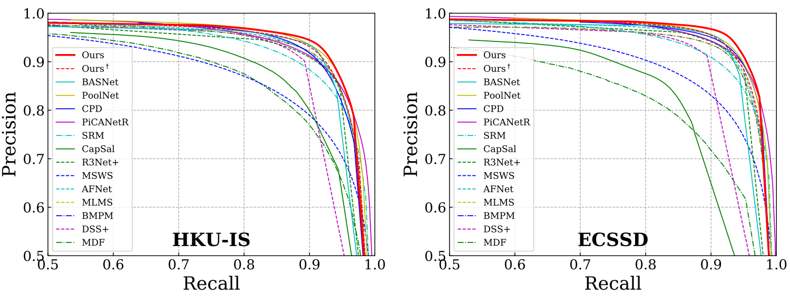
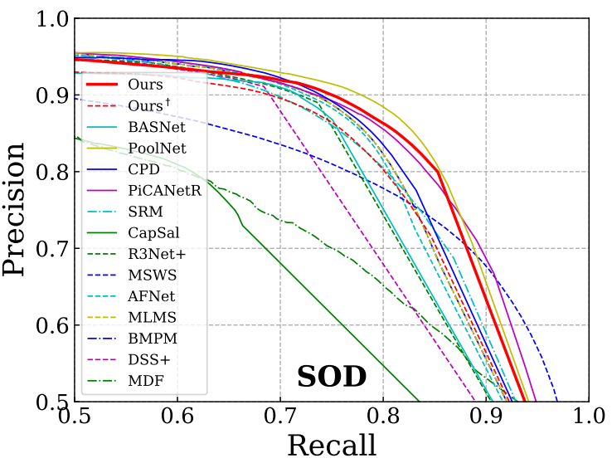
Quantitative Comparison(PR-curve)

Slide 23
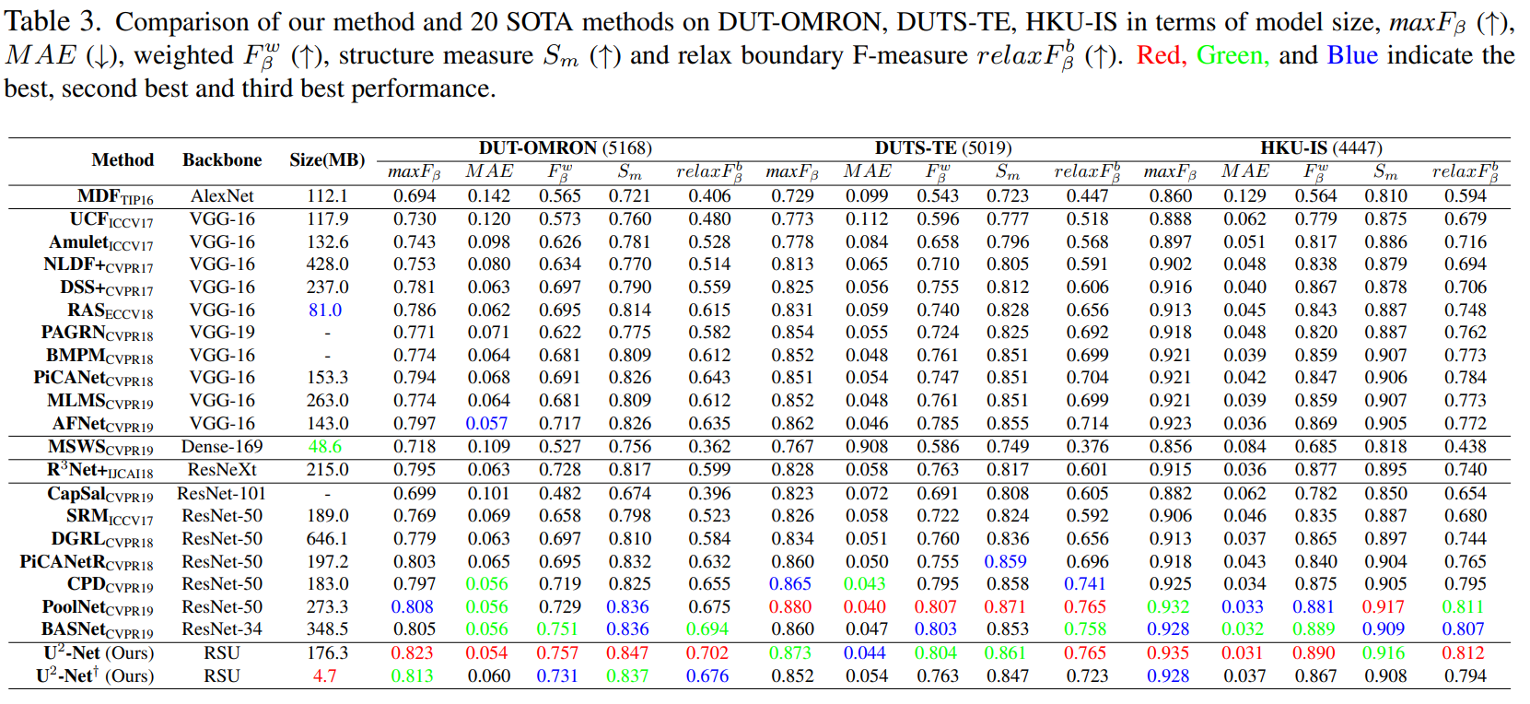
Table - Comparison 1

Slide 24
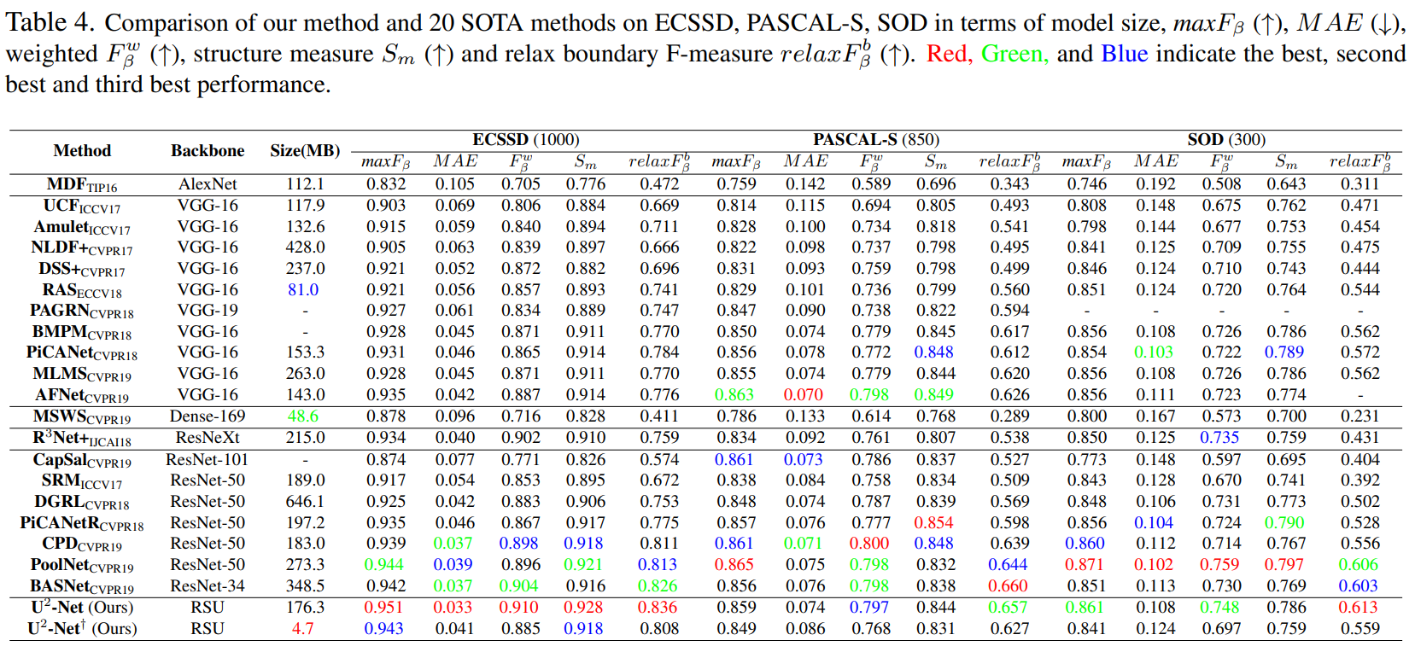
Table - Comparison 2

Slide 25
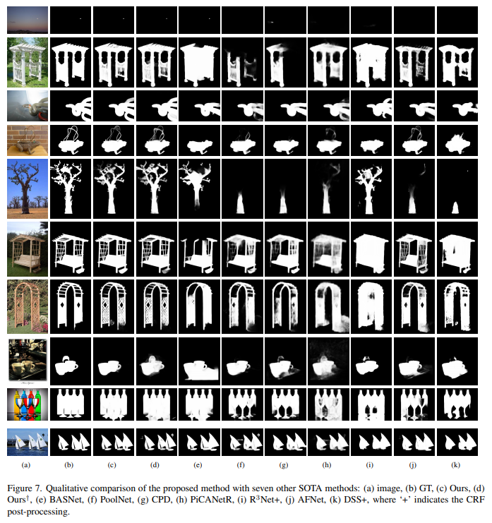
Qualitative comparison
Large obj
small obj
touch borders
Large, thin
clean backgrond
clean backgrond
detail
clutter background
complicated foreground
multiple targets

Slide 26
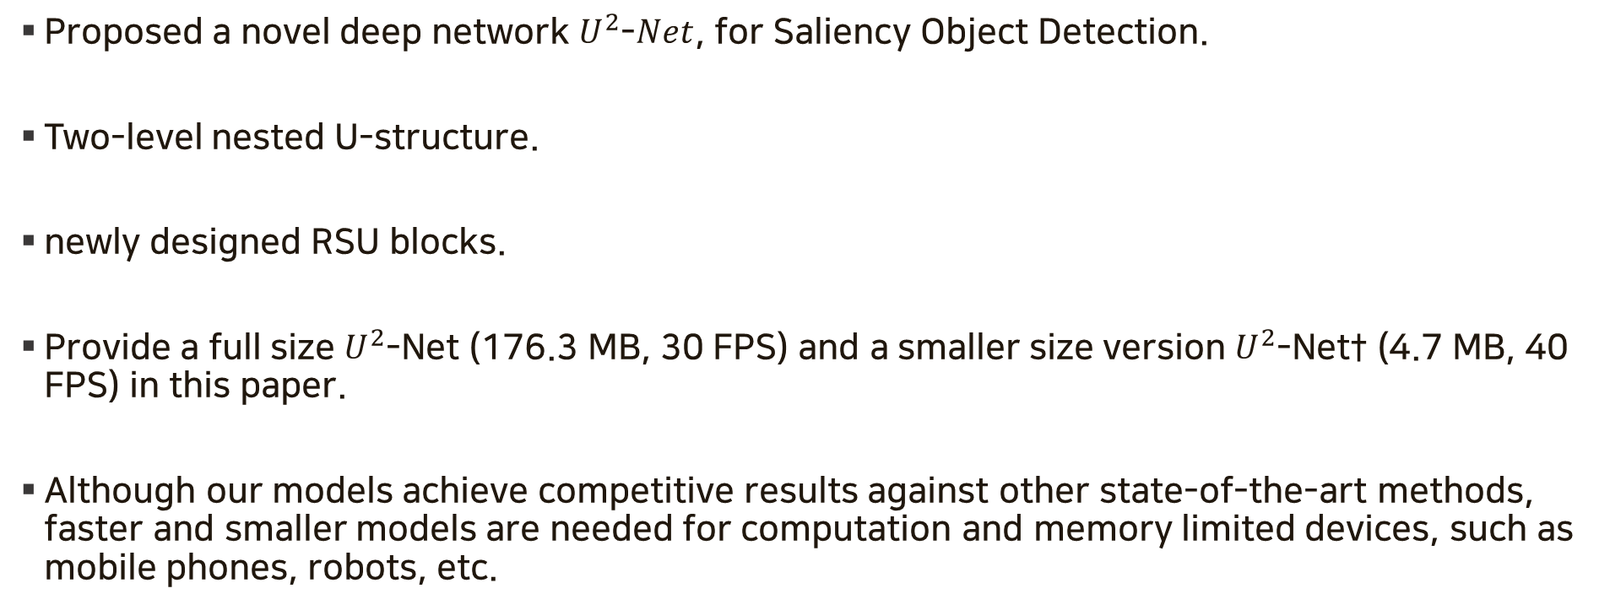
Conclusion
Proposed a novel deep network $U^{2}$-$Net$, for Saliency Object Detection.
Two-level nested U-structure.
newly designed RSU blocks.
Provide a full size $U^{2}$-Net (176.3 MB, 30 FPS) and a smaller size version $U^{2}$-Net† (4.7 MB, 40 FPS) in this paper.
Although our models achieve competitive results against other state-of-the-art methods, faster and smaller models are needed for computation and memory limited devices, such as mobile phones, robots, etc.

